Slide 1
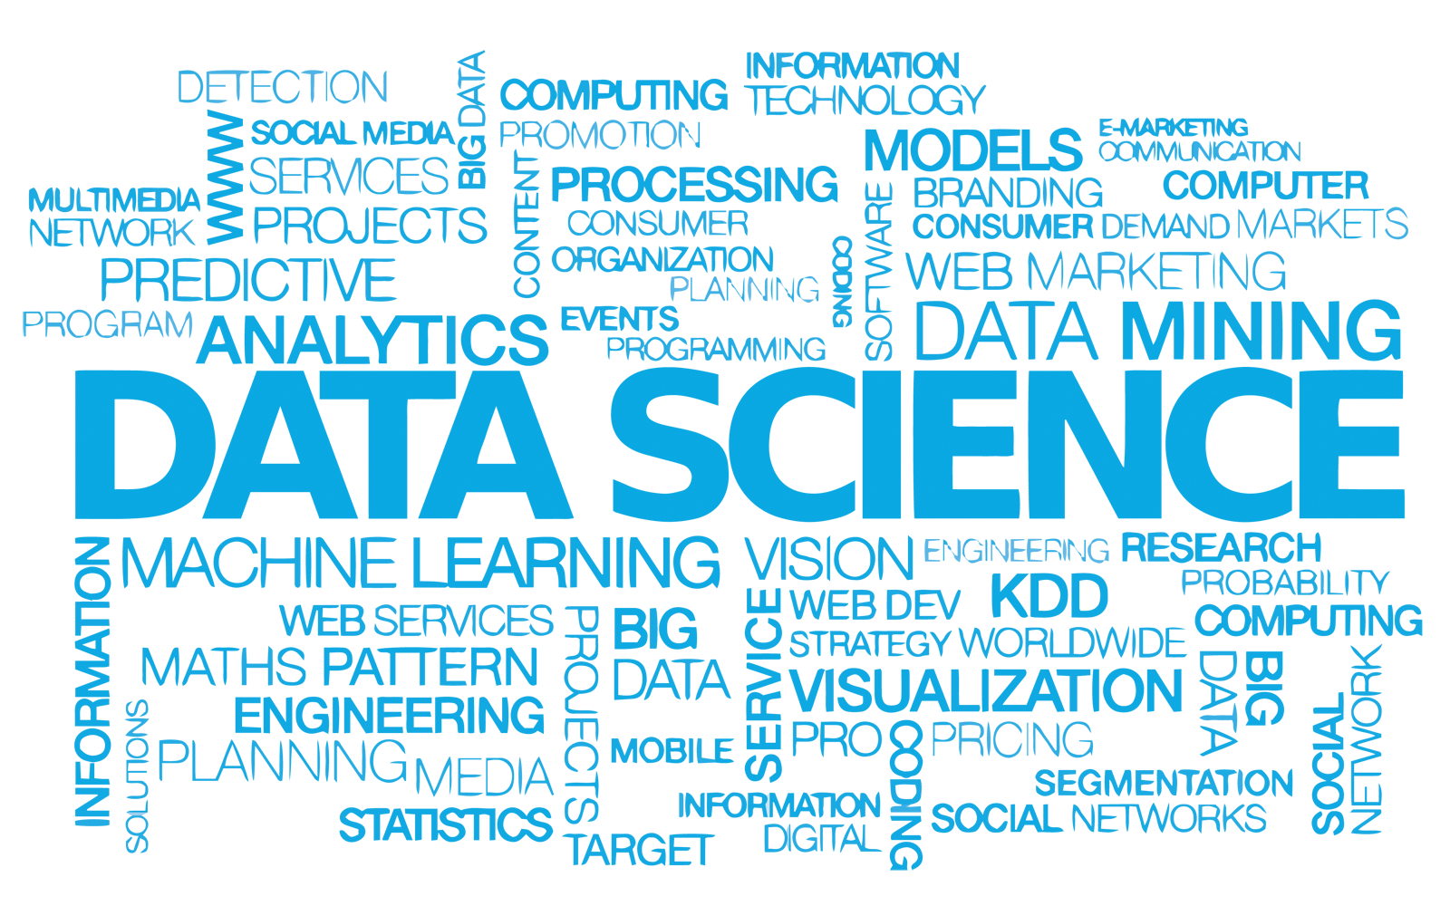
Data Science Vocabulary

Slide 2

INTRODUCTION TO DATA SCIENCE
SUBMITTED BY:
VANSH KUMAR THAKUR
COURSE:
M.SC DATA SCIENCE
SEMESTER:
FIRST ( I ST )
SUBMITTED TO:
MS NEEMA JHA
(ASSISTANT PROFESSOR)

Slide 3

What is Data Science?
“Data science, also known as data-driven science, is an interdisciplinary field of scientific methods, processes, algorithms and systems to extract knowledge or insights from data in various forms, either structured or unstructured, similar to data mining.”
5

Slide 4
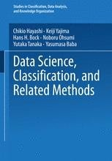
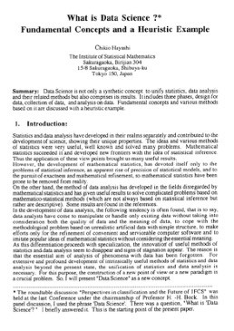
What is Data Science?
“Data science, also known as data-driven science, is an interdisciplinary field of scientific methods, processes, algorithms and systems to extract knowledge or insights from data in various forms, either structured or unstructured, similar to data mining.”
“Data science intends to analyze and understand actual phenomena with ‘data’. In other words, the aim of data science is to reveal the features or the hidden structure of complicated natural, human, and social phenomena with data from a different point of view from the established or traditional theory and method.”
5

Slide 5
What is Important?
Need to solve a real problem using data… No applications, no data science.

Slide 6

Data Science as a Unifier
Humanities
Machine/
Data Management
Statistical Learning
Data Science
Application Domain Expertise
Law
Social Science
Visualization
Mathematical Optimization

Slide 7
Data Science and Big Data
They are not the “same thing”
Big data = crude oil
Big data is about extracting “crude oil”, transporting it in “mega tankers”, siphoning it through “pipelines”, and storing it in “massive silos”
Data science is about refining the “crude oil”
Carlos Samohano Founder, Data Science London

Slide 8


Data Science and Artificial Intelligence
Data Science
Artificial Intelligence
ML/DM/ Analytics
“Data science produces insights.
Machine learning produces predictions”
Canadian Data Science Workshop
10

Slide 9
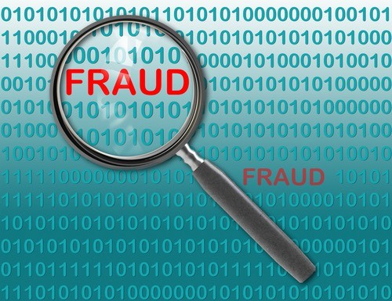
Data Science Application Examples
Fraud detection
Investigate fraud patterns in past data
Early detection is important
Before damage propagates
Harder than late detection
Precision is important
False positive and false negative are both bad
Real-time analytics

Slide 10
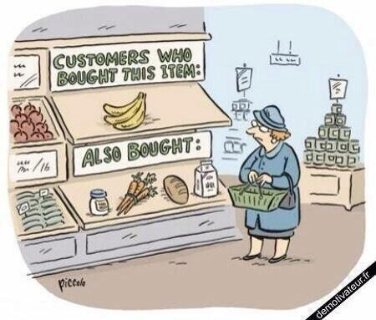
Data Science Application Examples
Recommender systems
The ability to offer unique personalized service
Increase sales, click-through rates, conversions, …
Netflix recommender system valued at
$1B per year
Amazon recommender system drives a 20-35% lift in sales annually
Collaborative filtering at scale

Slide 11

Data Science Application Examples
Predicting why patients are being readmitted
Reduce costs
Improve population health
Find the “why” behind specific populations being readmitted
Data lakes of multiple data sources
Investigate ties between readmission an socioeconomic data points, patient history, genetics, …
d

Slide 12
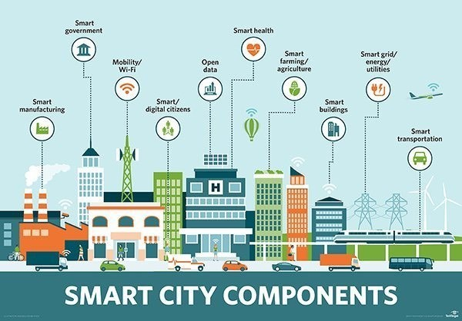
Data Science Application Examples
“Smart cities”
Not well-defined
14

Slide 13

Data Science Application Examples
Moneyball
How to build a baseball team on a very low budget by relying on data
Sabermetrics: the statistical analysis of baseball data to objectively evaluate performance
2002 record of 103-59 was joint best in MLB
Team salary budget: $40 million
Other team: Yankees
Team salary budget: $120 million

Slide 14


Holistic Approach to Data Science
Core
Data Security & Privacy
Data
Making Data Trustable & Usable
Data
Management of Big Data
Modeling & Analysis
Dissemination & Visualization
Acquisition
Preservation
Ethics, Policy & Social Impact
Application
Application
Application
Application

Slide 15
Core Research Issues & Interactions
Making Data Trustable & Usable
Big Data Management
Modelling & Analysis
Data
Visualization & Dissemination
17

Slide 16
Core Research Issues & Interactions
Data cleaning
Sampling
Data provenance
Making Data Trustable & Usable
Big Data Management
Modelling & Analysis
Data
Visualization & Dissemination
17

Slide 17
Core Research Issues & Interactions
Data cleaning
Sampling
Data provenance
Making Data Trustable & Usable
Data lakes
Batch & online access
Platforms
Big Data Management
Modelling & Analysis
Data
Visualization & Dissemination
17

Slide 18
Core Research Issues & Interactions
Data cleaning
Sampling
Data provenance
Making Data Trustable & Usable
Data lakes
Batch & online access
Platforms
Big Data Management
Modelling & Analysis
Models & methods for data lakes
Unsupervised classification & AI
Data
Visualization &
Dissemination
17

Slide 19
Core Research Issues & Interactions
Data cleaning
Sampling
Data provenance
Making Data Trustable & Usable
Data lakes
Batch & online access
Platforms
Big Data Management
Modelling & Analysis
Visualization for wider audience
Visualization for data exploration
Models & methods for data lakes
Unsupervised classification & AI
Data
•
Open data technologies
Visualization &
Dissemination
17

Slide 20
Core Research Issues & Interactions
Data cleaning
Sampling
Data provenance
Making Data Trustable & Usable
DM support for provenance
Data preparation for big data management
Data lakes
Batch & online access
Platforms
Big Data• Cleaning for data
Modelling & Analysis
Managementanalysis
DM for ML
ML for DM
Visual analytics
…
Data
Visualization for wider audience
Visualization for data exploration
Models & methods for data lakes
Unsupervised classification & AI
•
Open data technologies
Visualization &
Dissemination
17

